Slide 1
In-Building Wireless Program
Overview
This Photo by Unknown Author is licensed under CC BY-SA
This Photo by Unknown Author is licensed under CC BY-SA

Slide 2
Background
New building construction material significantly reduce indoor radio coverage
District of Columbia Legislation / IFC Adoption (2015) to provide for public safety (emergency responder) coverage in buildings
  Language is general
  Mandatory for newly constructed facilities
  Specifies that building owners must comply with OUC requirements, specifications, and criteria.
  Requirements apply to existing buildings if opting to install a BDA
The FCC requires that BDAs owners obtain from the frequencies licensee an authorization to transmit
Experience demonstrates that poor selection of BDA technology and/or poor engineering practices can dramatically hurt the host network (the P25 public safety network).

Slide 3
Examples of Negative Impact of BDAs On DC Radio Network
September 2013:
  A BDA improperly set up did shut down several frequencies system wide for 1 week
January 2015:
  A poorly maintained BDA/DAS system disrupted firefighters communications during an event at L’Enfant Plaza metro station
December 2016:
  A BDA improperly set up created interference to the St Elizabeth site impacting quality of service
March 2017:
  A BDA improperly set up impacted quality of service around the Freedom Plaza
June 2017:
  A BDA improperly set up created interference into 3 sites, significantly degrading the coverage and intermittently shutting down channels
December 2018
  A BDA improperly set up created interference into all channels, significantly degrading the coverage and intermittently shutting down channels
April 2019:
  A failing BDA created interference into all 800 MHz channels

Slide 4
Inbuilding Systems: What are they?
“In-building systems” are known as “DAS” in the industry, a bit misleading as they are made of
2 components:
  Bi-Directional Amplifier (BDA) picks up signal off-the air from the Host site from a donor antenna and repeats it down to a
  Distributed Antenna System (DAS) that through a set of small antennas and coax or fiber cables brings the signal into the depths of the building
  Reversely the DAS antennas pick up the signal from radio devices, transport the signal through the coax/fiber cables to the BDA. The BDA repeats the signal towards the Host site through the donor antenna

Slide 5
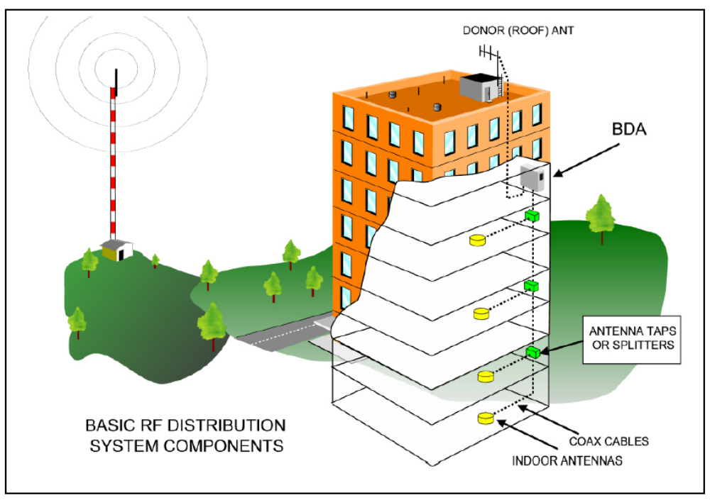

Slide 6
Frequent BDA/DAS Technical Issues
Mild uplink interference: Incrementally reduces the uplink coverage across the whole site coverage including users outside of the building
Severe uplink interference: Can shut down frequencies across the whole system
Near-far effect: Users close to the antenna can blind the system to the detriment of users further out
External Interference: Can shut down frequencies or blind the DAS
Spill: Coverage from the DAS outside the building can interfere with existing coverage
Oscillation: Feedback effect created by lack of isolation between the donor antenna and the DAS antennas

Slide 7
Other Issues Encountered
Poorly designed systems
  Default settings or max power
Lack of remote monitoring capabilities:
  Need to connect and upgrade equipment if necessary
Poor or non-existent maintenance of the equipment:
  Need preventative testing
Notes:
No OUC budget

Slide 8
Process

Slide 9
Preliminary Comments
Documentation available at:
  https://ouc.dc.gov/page/oucs-public-safety-building-radio-systems-requirements
All email communications with OUC to:
  Das.ouc@dc.gov
All communications with OUC shall include a site code reference
  To obtain the code, execute step 1 of the process described in following slides
  Communications that do not include site code will be ignored.

Slide 10
Mandatory Sequence of Tasks
Step 1 – Project Initiation
  Building owner submits an authorization request
  OUC adds to database and assigns unique ID / Site Code Number
Step 2 – Design Validation
  Building owner submits design documentation / equipment specifications / personnel certifications
  OUC reviews and approves P25 solution design documentation / submittals
  Vendor installs equipment
Step 3 – System Acceptance
  OUC approved vendor inspects system upon installation complete
  OUC approved vendor coordinates test schedule with OUC
  OUC approved vendor conducts testing per OUC requirements / submits results
  Building owner submits As-Built diagrams and cable sweep results
  OUC coordinates Fire Marshall test
  OUC provides transmission authorization letter
Step 4 – Continuous Operation / Annual Inspection
  System monitoring via OCTO-NOC
  OUC maintains remote access and credentials for emergency shut down of P25 system
  OUC maintains emergency contact info
  Building owner provides scheduled maintenance
  Annual test / inspection by OUC authorized vendor
Building Owner Costs
Testing by OUC approved vendor
Equipment maintenance contracts
Remote monitoring licenses
Remote access and monitoring connectivity
Annual testing by OUC approved vendor
Notes:
Hello, I’m (Name, Title, Agency)
I’m here to introduce you to the proper use of the (APX 7000) This instruction will cover the basic functions.
I’m going to go over the basic functionality of the radio that will be issued to the vast majority of you to support the Presidential Inauguration operations on January 20th of 2013.
These radios will be assigned to your agency about a week before Inauguration.
Your agency lead, agency Director, or agency representative will sign for these radios.
These radios are valuable and expensive pieces of equipment.
By your agency accepting responsibility for the radio you in turn will accept responsibility for the radio so it’s essential that you maintain it on your person at all times.
Don’t place it down on a table and walk away from it. Keep it with you and maintain accountability for it.

Slide 11
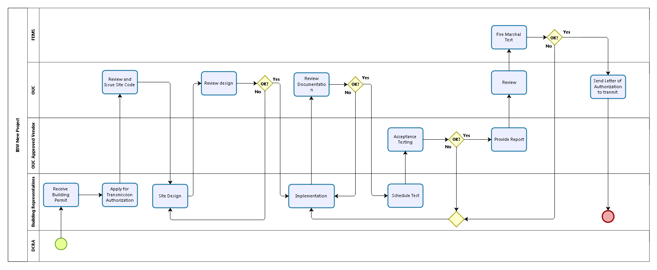
OUC Transmission Authorization Process

Slide 12
Technical Requirements Summary
Non Exhaustive: Please Read Posted Documentation

Slide 13
Technical Requirements
Frequencies:
  Frequencies listed on OUC Website
Emergency Coverage Solution
  BDA + DAS
Equipment Requirements
  P25: Channelized, uplink squelch

Slide 14
Performance Requirements
Coverage Scope:
  95% percent of all areas on each floor
  99% of critical areas: emergency and standby power rooms, elevator lobbies, exit stairs and exit passage ways and elevator machine rooms
Coverage Objective
  Signal strength
  DAQ
Interference
  Uplink noise 15dB below noise floor
  Isolation

Slide 15
Other Requirements
Power Backup:
  24 hours
  4 hours if Emergency Power (generator) available
Monitoring
  24x7 Emergency contact
  Shut down switch in Fire Control room
  Secure IP OpenVPN access for emergency remote shutdown
  Alarms to OUC’s NOC
Enclosures:
  NEMA4

